Slide 1



NEUROFLEETX: THE AI-DRIVEN URBAN MOBILITY OPTIMIZATION PLATFORM
A NEXT-GENERATION SOLUTION FOR SMART CITIES, FLEET OPERATIONS & RENTAL TRANSPORT

Slide 2

Introduction
NeuroFleetX is a next-generation, AI-driven platform designed to revolutionize urban mobility by leveraging the power of AI, IoT, and geospatial data to optimize fleet operations and rental transport within smart cities. By providing geo-located, real-time vehicle tracking and advanced dashboards, the platform enables intelligent, detailed routing, predictive vehicle health monitoring, and automated management systems. This mobile-first interface is built for scalability, offering sustainable mobility solutions that enhance vehicle management and contribute to a greener, more efficient urban ecosystem.

Slide 3


Problem Statement
Problem: Urban mobility today is reactive and inefficient, plagued by unpredictable traffic, unscheduled vehicle downtime, and a lack of real-time data. This leads to wasted time and fuel, increased operational costs, and significant environmental impact from vehicle emissions.
Solution: NeuroFleetX is a proactive, AI-driven platform that solves these challenges. By integrating AI, IoT, and geospatial data, we enable dynamic route optimization and predictive maintenance. Our system provides a unified, real-time view of your entire fleet, transforming reactive chaos into a data-driven, sustainable, and highly efficient operation.

Slide 4

Tech Stack
This project leverages a modern, cohesive tech stack built for real-time data handling and scalability. The separation of concerns between the frontend and backend ensures a robust and maintainable application.
Technology Stack
The project utilizes a modern, cohesive tech stack built for real-time data handling and scalability. Each component was chosen to work seamlessly with the others, enabling efficient development and a high-performance application.
Backend: Node.js & Express
The backend is built on Node.js and the Express.js framework, which is excellent for building scalable, high-performance APIs for real-time applications.
Authentication & Database: We've integrated the Firebase Admin SDK for secure, server-side authentication and Firestore as our NoSQL database. This combination provides a fully managed, scalable solution for user and vehicle data.
Real-time: We use the native WebSocket (ws) library to create a persistent connection for pushing live, simulated vehicle updates to the frontend, ensuring real-time tracking is responsive and efficient.
Middleware: Custom Express middleware handles core functionalities: isAuthenticated verifies the user's Firebase ID token, and hasRole enforces Role-Based Access Control (RBAC) based on custom claims.

Slide 5
Frontend: React
The user-facing application is a React single-page application, using Create React App for a fast and efficient setup.
Authentication: The Firebase Web SDK handles all client-side authentication, including user registration and login. It securely passes the user's ID token to the backend for verification.
Mapping: We use the Google Maps API via the @googlemaps/react-wrapper library to display live vehicle locations in a familiar and interactive interface.
State Management: React Context is used for global state management, making user authentication status and roles accessible throughout the application without complex prop drilling.
Styling & UX: A custom dark theme and a responsive grid layout provide a clean, professional, and consistent user experience.
AI/ML Logic: Python Microservice
To handle the more complex and computationally intensive tasks, we use a separate Python microservice.
Rationale: Python is the industry standard for AI/ML due to its extensive libraries like TensorFlow and PyTorch. By decoupling this logic into a microservice, we ensure our main Node.js backend remains fast and focused on real-time data while the AI component can scale independently. The Node.js backend communicates with this service via internal REST API calls.

Slide 6

Work Done
We've successfully established a robust and functional foundation for the NeuroFleetX platform. This completed work provides the core infrastructure necessary to build out more advanced features.
Full-Stack Foundation: A complete and integrated setup with a Node.js/Express.js backend and a React frontend, ensuring a modular and scalable architecture.
Database and Authentication: Full integration with Firebase, utilizing Firestore for data storage and Firebase Authentication for secure user management, including a full registration and login system.
Core CRUD API: All essential backend APIs for Creating, Reading, Updating, and Deleting vehicle data are built and secured.
Real-Time Live Tracking: The platform features a working WebSocket connection that pushes live, simulated vehicle location data from the backend to a Google Map on the frontend, a critical component for fleet visibility.
Role-Based Access Control (RBAC): A foundational RBAC system is implemented using Firebase ID tokens and custom claims to restrict certain API actions and UI components to an 'admin' role

Slide 7
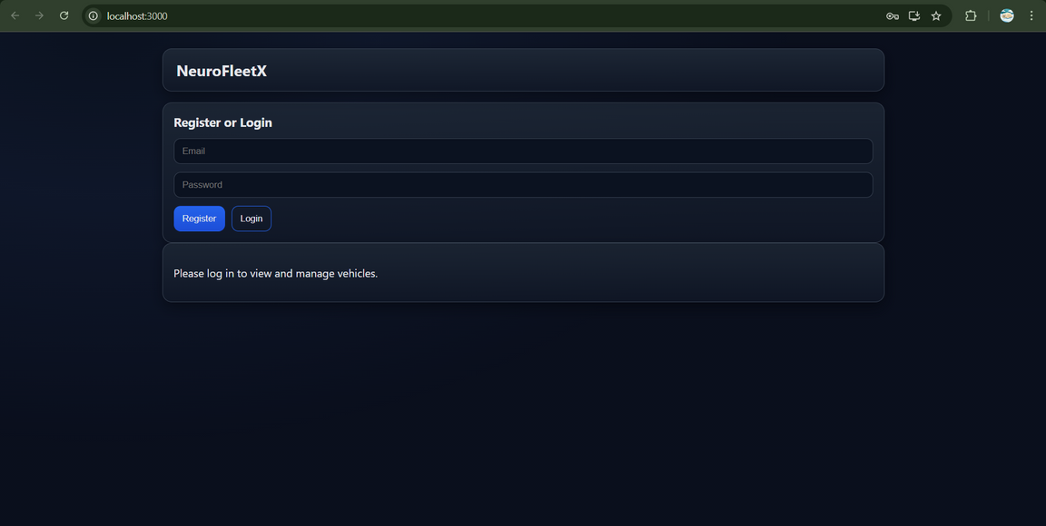
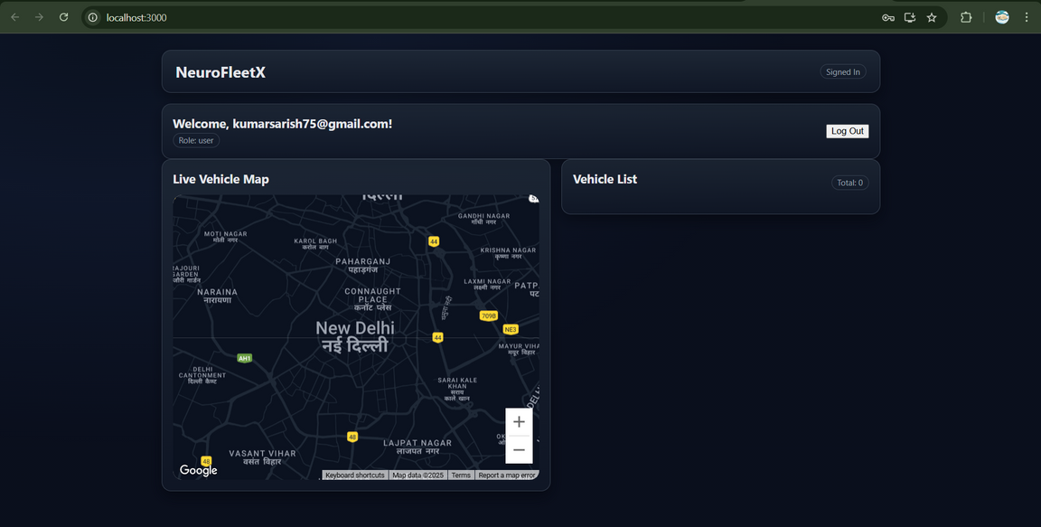

Slide 8
Work To Do
With the core infrastructure in place, our focus shifts to developing the advanced, AI-driven features that will differentiate NeuroFleetX in the market.
Predictive AI: Build a separate Python microservice for predictive maintenance (predicting vehicle issues) and dynamic route optimization (real-time routing recommendations).
Comprehensive Dashboards: Create dedicated dashboards for administrators and fleet managers with data visualization via charts for key metrics like vehicle utilization and fuel efficiency.
Notifications System: Implement a real-time notification system for alerts on events like maintenance flags or traffic surges.
Advanced User Roles: Expand the RBAC system to include 'driver' and 'fleet manager' roles, with specific access permissions.
Driver Analytics: Implement an AI model to analyze driver behavior and create a risk score for improved safety.
Demand Prediction: Use machine learning to predict high-demand areas, enabling optimal vehicle dispatching.
Geofencing & Alerts: Allow administrators to create virtual boundaries and receive automated alerts for vehicle movements.
Energy Management: Develop a system to monitor and optimize fuel/battery usage.
Third-Party API: Create a public-facing API for integration with other services and smart city systems.

Slide 9
Theory
Data Integration: Sourcing and harmonizing data from diverse sources (IoT sensors, traffic APIs) is complex.
Scalability: The system must handle a high volume of users and a constant influx of real-time data without performance degradation.
Model Accuracy: The effectiveness of the AI models for predictive maintenance and dynamic routing depends on their reliability in unpredictable real-world environments.
Cost: The use of paid APIs like Google Maps can lead to significant operational costs.
Data Privacy: The collection of vast amounts of geospatial data raises significant ethical and legal concerns regarding user privacy.
Algorithmic Bias: AI models could lead to unfair outcomes if trained on biased data, such as recommending less efficient routes in certain areas.
Deployment Complexity: A multi-stack system (Node.js and Python) requires a robust DevOps pipeline for seamless deployment and maintenance.
Market Acceptance: Gaining traction in the highly competitive urban mobility market requires a strong, proven value proposition.
Sensor Integration: Moving from simulated data to real-world sensors introduces challenges with data noise, inconsistency, and connectivity issues.

Slide 10
THANK YOU

